Slide 1

Debating voting systems
Andras Meleg
30 March 2022

Slide 2
Relevance
We all want to live in a fair world.
Public Choice Theory: question of transitivity

Slide 3
Warm-up video from primer 3 basic Voting systems
 | Plurality | Instant runoff | Approval
Summary | Vote for one | Rank all | Vote for any number
Other name | First past the post | Ranked choice | Score (subtype)
Flaw | Spoiler effect | Center squeeze | Chicken dilemma
Strategy | Pick from top two | Sometimes betray favourite | Sometimes betray non-favourites

Slide 4
Agenda
Basics:
Restrictions of decision-making:
Condorcet – criterion
Black’s Median-voter theorem
Arrows’ impossibility theorem
Sen’s liberal paradox
Good-to-have knowledge snippets :
Representation error
Spoiler-effect (FPTP, MNTV, IR)
Chicken-dilemma (AV)
How gerrymendering works? (FPTP )
Spatial distribution model
Electronic voting
Specific voting systems:
First Past The Post (FPTP)
Instant-runoff (IR)
Approval voting (AV)
Borda-count (BC)
Mixed-member proportional (MMP)
Multiple non-transferable vote (MNTV)
Single-Transferable-Vote (STV)
Cardinal voting (CV)
Takeaways

Slide 5
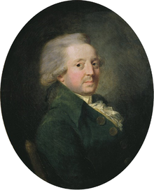
Condorcet method
https://www.youtube.com/watch?v=PaxVCsnox_4
Everyone competes with everyone
Condorcet criterion: you have to win every 1v1 pair to win
https://www.youtube.com/watch?v=HoAnYQZrNrQ
Essay on the Application of Analysis to the Probability of Majority Decisions (1785)

Slide 6
Condorcet method
Suppose majorities prefer, for example, candidate A over B, B over C, and yet C over A. When this occurs, it is because the conflicting majorities are each made up of different groups of individuals.
Impact: expectation of transitivity on the part of all individuals’ preferences should result in transitivity of societal preferences is a fallacy of the composition!
Quickfix 1: Cardinal ratings → vector votes
Quickfix 2: Large society → 3 options, 100 voters: 5%, 1000 voters: 0.5%, 10000 voters: 0.05%
Suppose we have a WUDC final: we have 99 judges, and teams and OG clearly lost the debate with a bad model. What is the chance that we will get a fair World Champion? (95%) → if there is 1 bad team every year in the finals, we get 1 unworthy world champion every 20 years?
More practical implementation: two-stage voting process can be harmful

Slide 7
Condorcet method
Suppose majorities prefer, for example, candidate A over B, B over C, and yet C over A. When this occurs, it is because the conflicting majorities are each made up of different groups of individuals.
Impact: expectation of transitivity on the part of all individuals’ preferences should result in transitivity of societal preferences is a fallacy of the composition!
Quickfix 1: Cardinal ratings → vector votes
Quickfix 2: Large society → 3 options, 100 voters: 5%, 1000 voters: 0.5%, 10000 voters: 0.05%
Suppose we have a WUDC final: we have 99 judges, and teams and OG clearly lost the debate with a bad model. What is the chance that we will get a fair World Champion? (95%) → if there is 1 bad team every year in the finals, we get 1 unworthy world champion every 20 years?
More practical implementation: two-stage voting process can be harmful

Slide 8
Condorcet method
Suppose majorities prefer, for example, candidate A over B, B over C, and yet C over A. When this occurs, it is because the conflicting majorities are each made up of different groups of individuals.
Impact: expectation of transitivity on the part of all individuals’ preferences should result in transitivity of societal preferences is a fallacy of the composition!
Quickfix 1: Cardinal ratings → vector votes
Quickfix 2: Large society → 3 options, 100 voters: 5%, 1000 voters: 0.5%, 10000 voters: 0.05%
Suppose we have a WUDC final: we have 99 judges, and teams and OG clearly lost the debate with a bad model. What is the chance that we will get a fair World Champion? (95%) → if there is 1 bad team every year in the finals, we get 1 unworthy world champion every 20 years?
More practical implementation: two-stage voting process can be harmful

Slide 9
Condorcet method
Suppose majorities prefer, for example, candidate A over B, B over C, and yet C over A. When this occurs, it is because the conflicting majorities are each made up of different groups of individuals.
Impact: expectation of transitivity on the part of all individuals’ preferences should result in transitivity of societal preferences is a fallacy of the composition!
Quickfix 1: Cardinal ratings → vector votes
Quickfix 2: Large society → 3 options, 100 voters: 5%, 1000 voters: 0.5%, 10000 voters: 0.05%
Suppose we have a WUDC final: we have 99 judges, and teams and OG clearly lost the debate with a bad model. What is the chance that we will get a fair World Champion? (95%) → if there is 1 bad team every year in the finals, we get 1 unworthy world champion every 20 years?
More practical implementation: two-stage voting process can be harmful

Slide 10
Practice motion: THP voting systems selected with the condorcet method
Let’s find 2 arguments against this!

Slide 11
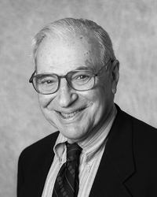
Arrows impossibility theorem
Social Choice and Individual Values (1951) → a monograph work based on his PhD (1951) (Nobel: 1972)
He called his theory general possibilty theorem
Its only 100 pages long, so you can get a grasp on the problem in a day: https://cowles.yale.edu/sites/default/files/files/pub/mon/m12-all.pdf
Proof in 30 mins: https://www.youtube.com/watch?v=LVkioI5Z0JE
He had help from many experts of course, f.e.: McKinsey, Hotelling
It’s based on Maths!
„Most systems are not going to work badly all of the time. All I proved is that all can work badly at times.” – Kenneth Arrow

Slide 12
General impossibility theory
0) exclude interpersonal comparisons of utility
1) nondictatorship
2) Individual soverignty (order + indicate ties)
3) Unanimity (if every individual prefers A to B, group ranking should do the same)
4) Freedom from irrelevant alternatives: choice removed, others’ order should not change

Slide 13
Practice motion: THP a world where every vote has the same weight
Let’s find 2 arguments against this!

Slide 14
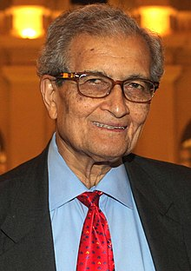
Liberal paradox
Amartya Kumar Sen:
1: Unrestrictidness Condition:
2: Pareto Condition:
3: Liberalism:
Collective Choice and Social Welfare (1970) (Nobel: 1988)
every ranking will be considered equally
if everybody individually likes some choice better, the society as a whole shall like it better
all individuals have min. 1 possibility of choosing differently so that the social choice changes as well.

Slide 15
Liberal paradox
Impact of liberalism:
Minimal liberalism:
Examples of minimal liberalism: Freedom of speech? Freedom to leave the society?
more than 1 individial in a society is decisive on a pair of social outcomes.
You can exert your freedom of choice at least in some decision with tangible results.
It captures an aspect of individual freedom: sometimes society respects your preferences for x over y, even if everyone is against you. Sen’s example: sleeping on back on side.

Slide 16
prevent the liberal paradox?
Sen’s paradox emerge when individuals have „nosy” preferences.
Sen’s suggestion: "The ultimate guarantee for individual liberty may rest not on rules for social choice but on developing individual values that respect each other's personal choices.„
Another prevention: Cardinal preferences
Alternative solution: reject the Pareto principle
our preference depends not only on our own action but on others’ actions. Similar to market efficiency: markets fail to produce Pareto outcomes in the presence of externalities. F.e.: pollution.

Slide 17
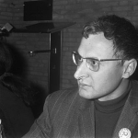
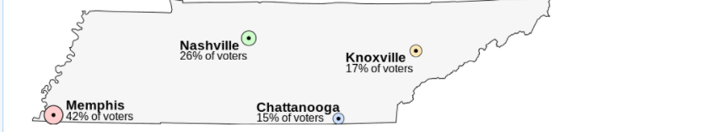
Median voter theorem
On the Rationale of Group Decision-making” (1948) by Duncan Black
1-dimensional spectrum + voters ranking alternatives in order of proximity
Any Condorcet criterion satisfying voting will elect the candidate closest to the median voter. Especially a majority vote between 2 options.
Question: does this provide you a strong justification for the Condorcet criterion?
What problem did we create here? → radicals will stay home?

Slide 18
First past the post
Everyone has 1 vote
You can vote for 1 option
Winner: most votes
Most notable nation: UK
Major flaws: Spoiler effect, representation error, radical pull

Slide 19
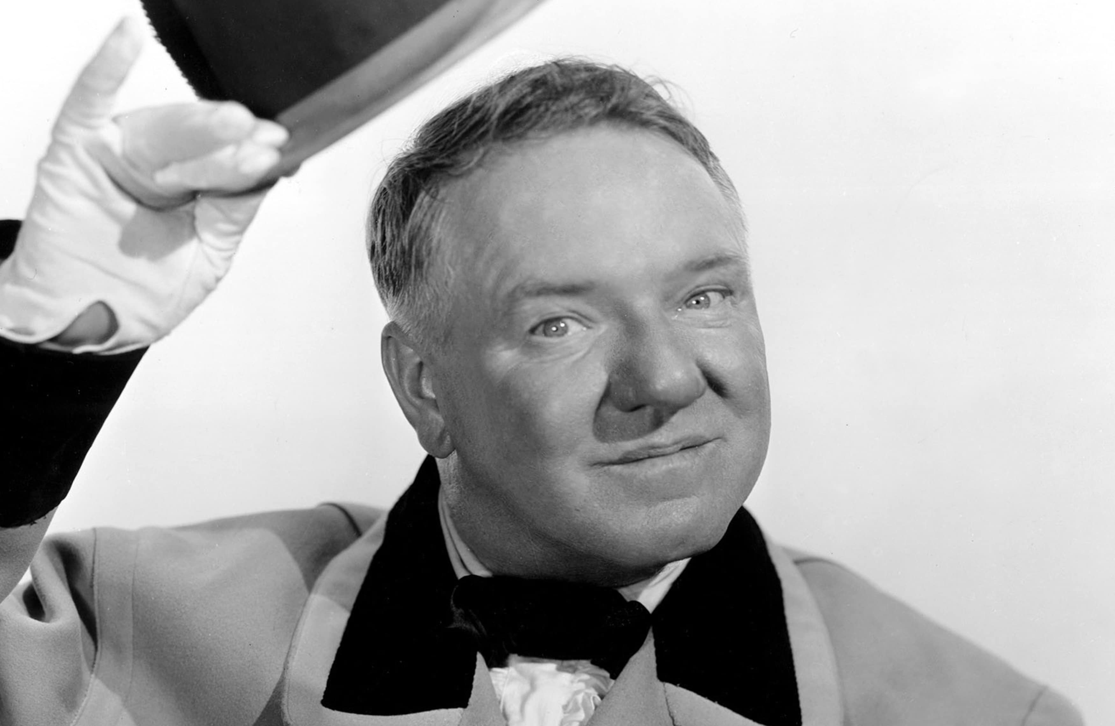
The spoiler effect
„I never voted for anybody. I always voted against.” W. C. Fields
Tactical voting: you are not voting to your most favoured candidate
Your preferences: A > B > C
Your expectation: A: 10 | B: 45 | C: 45
Result: you vote for B
Impact: most likely 2 party-system + representation error

Slide 20
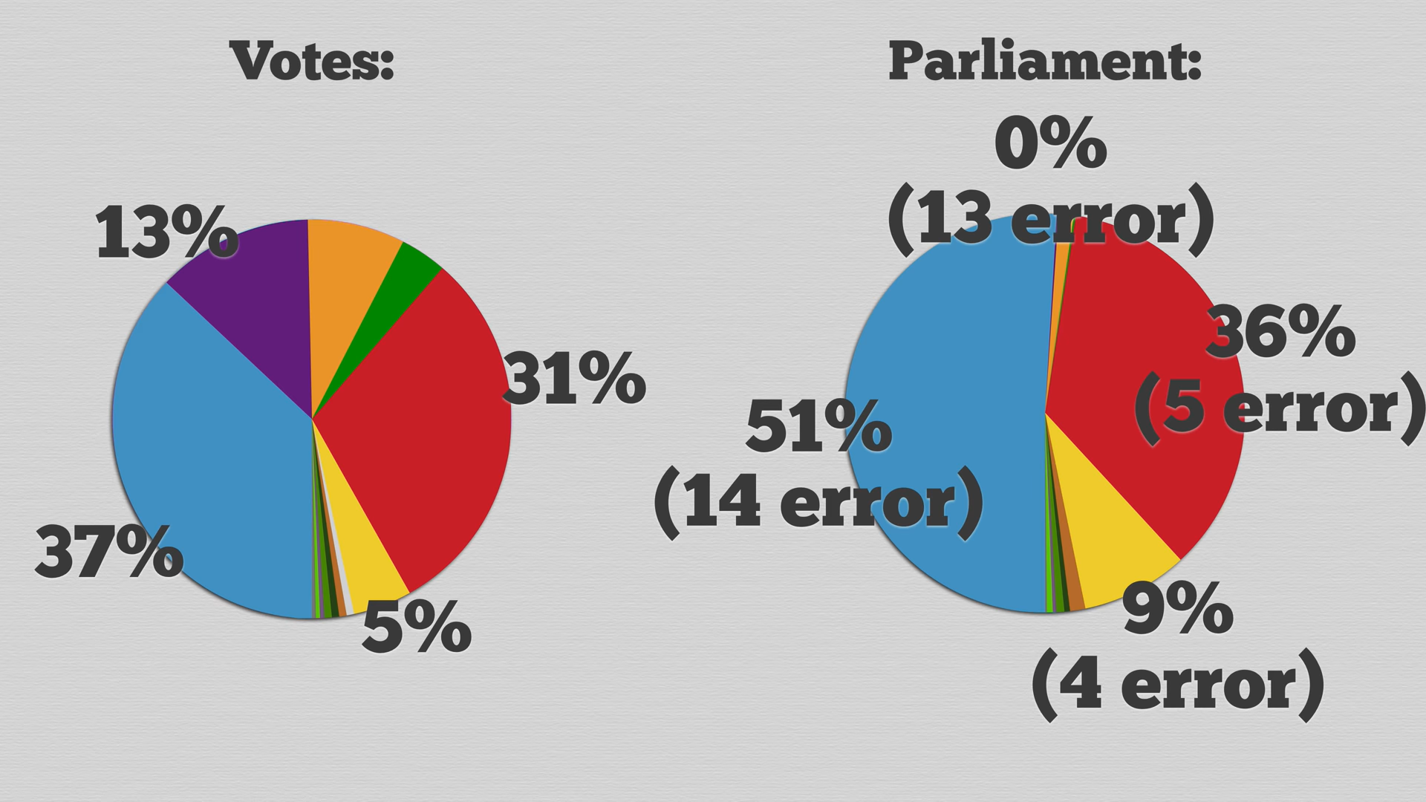
Error of representation
https://www.youtube.com/watch?v=r9rGX91rq5I

Slide 21
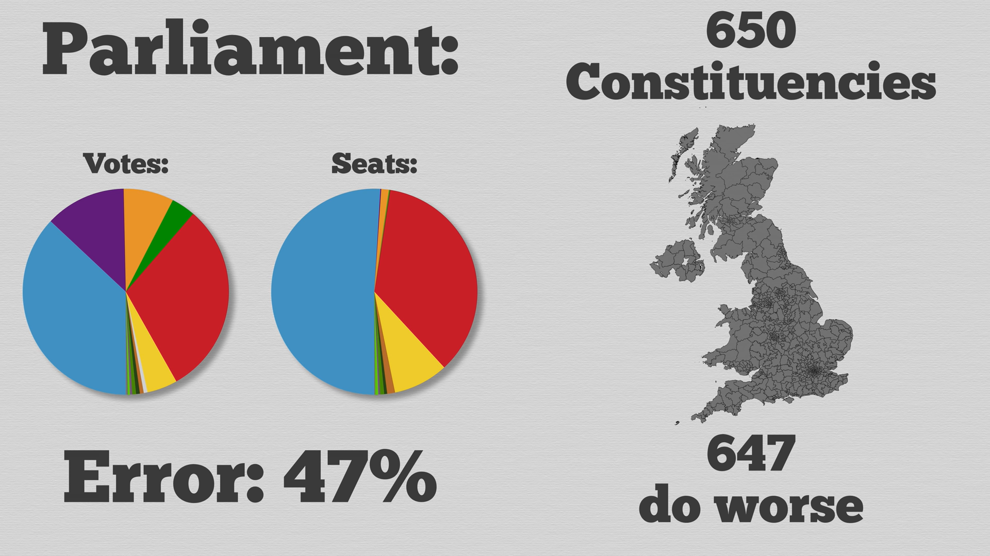

Slide 22
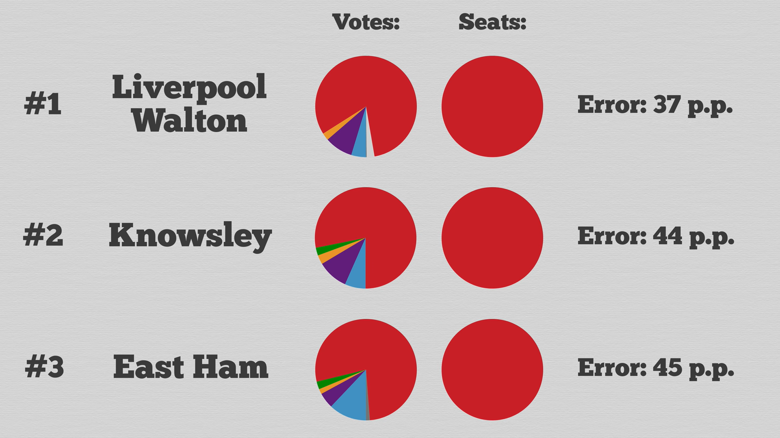

Slide 23
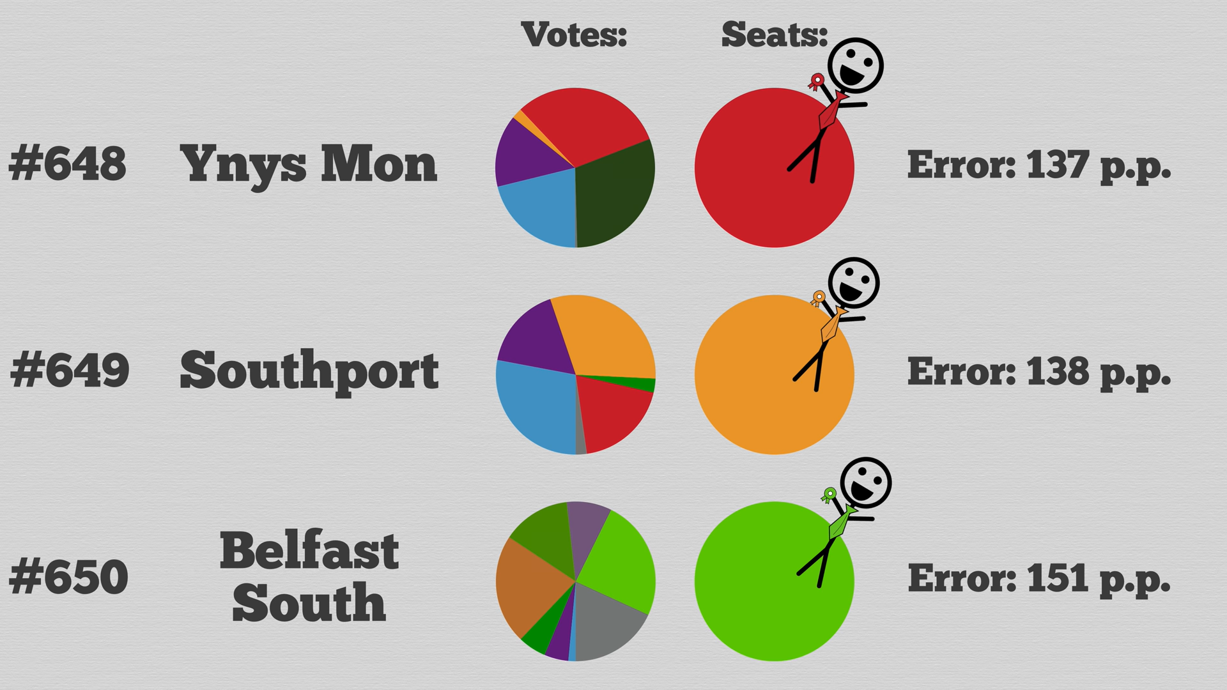

Slide 24
Instant runoff
Everyone can order their preference list from 1 to n, for n options
Least favoured option is eliminated
For eliminated option: 2nd choice added to the still competing opctions
Notable examples:
most Student Organizations use runoffs, f.e. Single positions in BDU, Oscars, Australia
2 round runoffs are very common: Előválasztás 2021, French or old Hungarian elections
Major flaws:
Center squeeze

Slide 25
Instant runoff
Everyone can order their preference list from 1 to n, for n options
Least favoured option is eliminated
For eliminated option: 2nd choice added to the still competing opctions
Notable examples:
most Student Organizations use runoffs, f.e. Single positions in BDU, Oscars, Australia
2 round runoffs are very common: Előválasztás 2021, French or old Hungarian elections
Major flaws:
Center squeeze
Is this the best voting system?

Slide 26
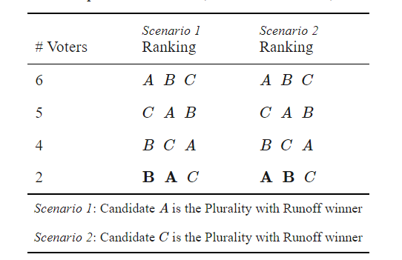
The failure of monotonicity
A voting method is monotonic provided that receiving more support from the voters is always better for a candidate.
Plurality (first past the post) is monotonic, but instant runoff isn’t. Sometimes its better not to gain support... Wow!

Slide 27
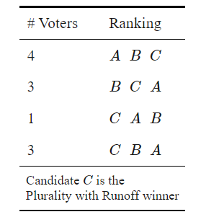
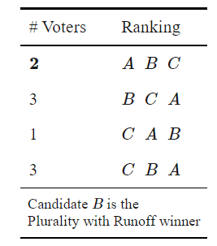
No show paradox
Its a variable population paradox
Sometimes a candidates can gain advantage, if their supporters don’t show up.
Fishburn and Brams: Paradoxes of preferential voting (1983)
Typical example: Instant-runoff
Theorem (Moulin 1988).
„If there are four or more candidates, then every Condorcet consistent voting method is susceptible to the no-show paradox.”

Slide 28
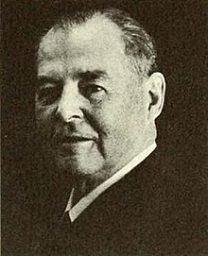
Spatial model
Origins of the idea: Hotelling’s law (principle of minimum differentiation)
We need at least 4 dimensions based on German voter data:
Impartial culture: we rank everyone
Stability in competition (1929) by Harold Hotelling (extremely impactful mathematical statistician,
if you ever studied statistics, you studied based on his foundations
developed and named the principal componenet analysis method which is a bread and butter skill for computer scientists)
Alós-Ferrer, C, & Granić, G.D. (2015). Political Space Representations with Approval Data. Electoral Studies, 39, 56–71. doi:10.1016/j.electstud.2015.04.003

Slide 29
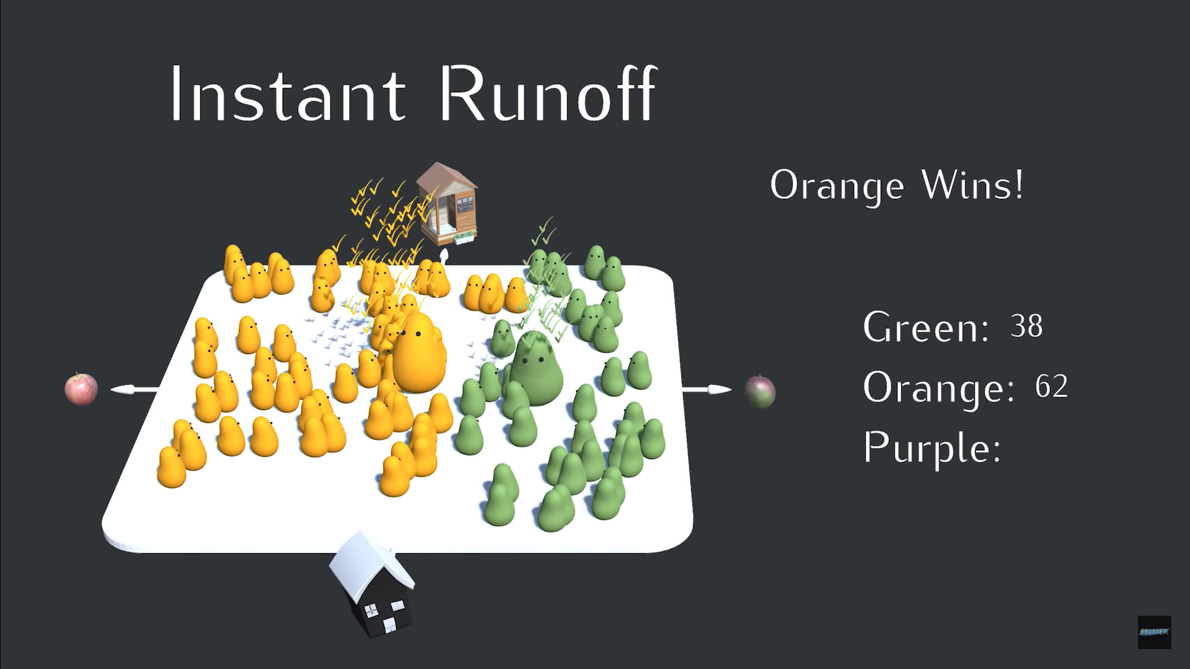
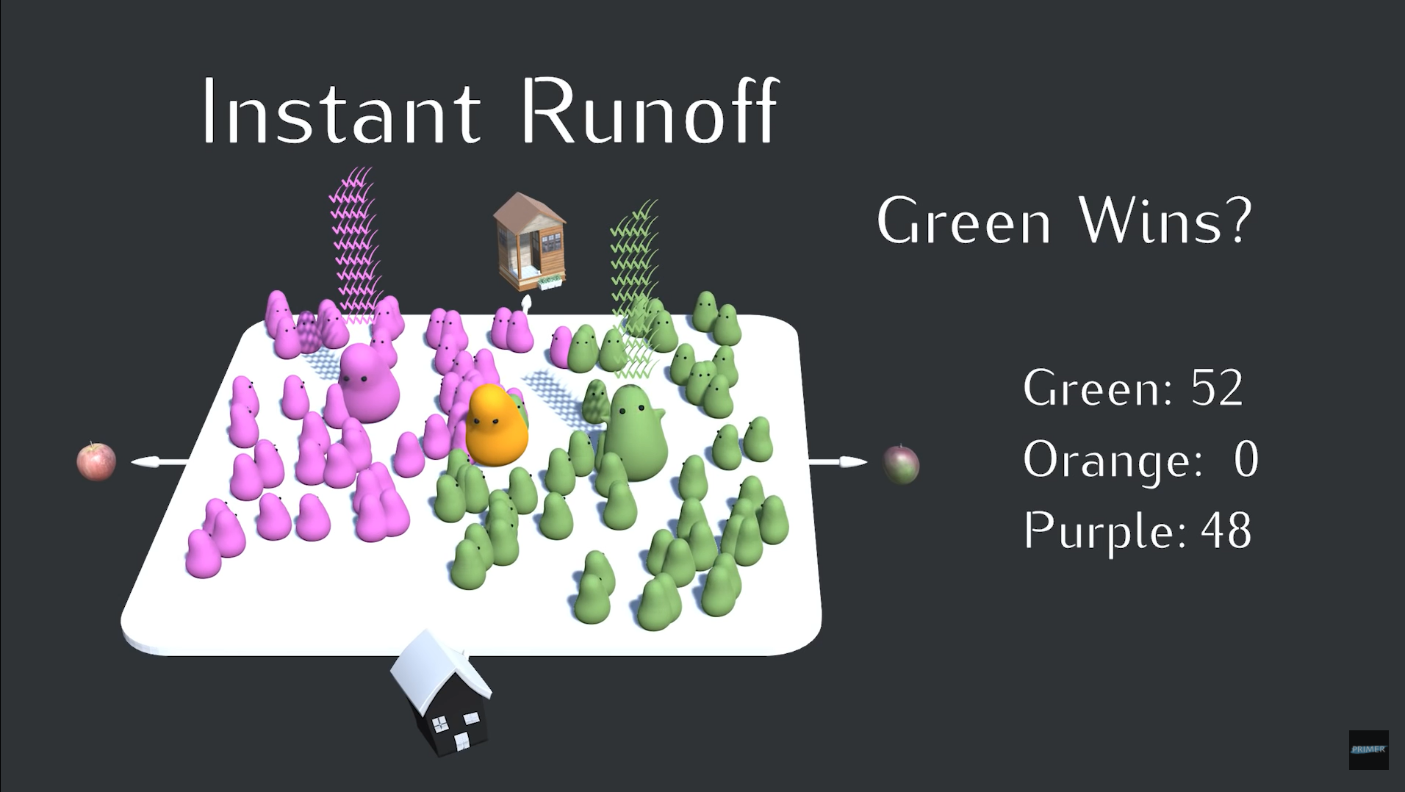
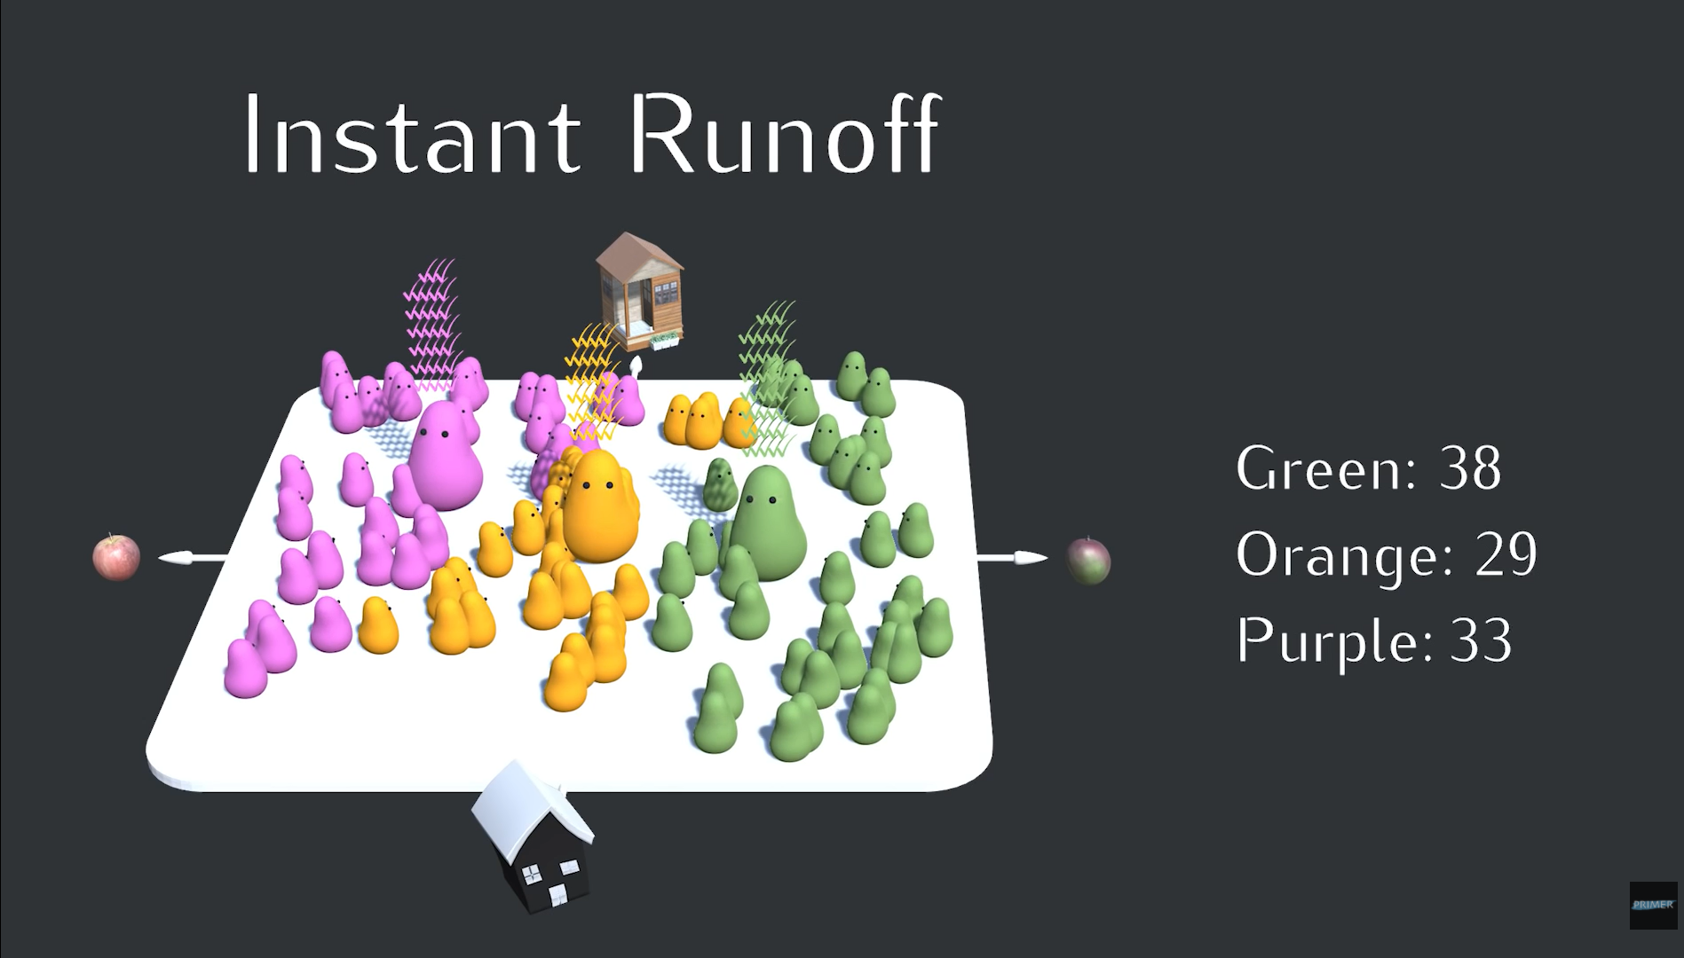
Center squeeze

Slide 30
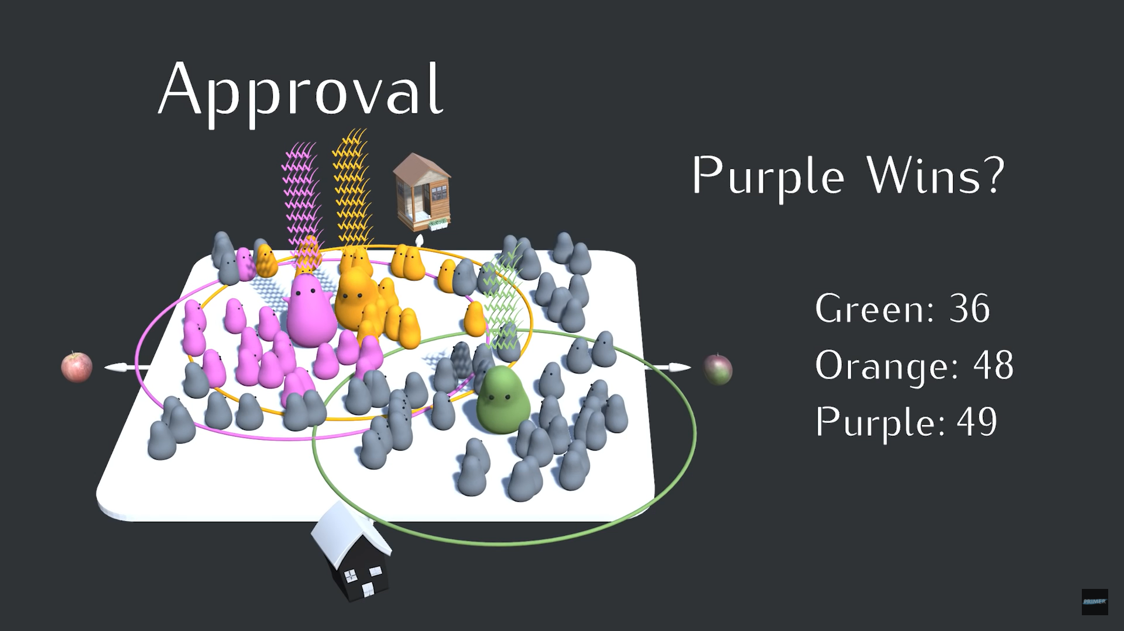
Approval voting
There are n candidates and you can submit a maximum of n votes on someone who you like
Major flow: sometimes betray non-favourites, often non-proportional

Slide 31
We are still gonna discuss
Borda-count (BC)
Mixed-member proportional (MMP)
Multiple non-transferable vote (MNTV)
Single-Transferable-Vote (STV)
Cardinal voting (CV)
But first: let’s focus on gerrymendering!

Slide 32


Gerrymendering

Slide 33
Gerrymendering

Slide 34
Gerrymendering

Slide 35
Gerrymendering

Slide 36
Gerrymendering

Slide 37
Gerrymendering

Slide 38
Gerrymendering
Error: 6%

Slide 39





Gerrymendering
Error: 6 + 2x20 = 46%

Slide 40





Gerrymendering
Error: 2x17 = 34%

Slide 41
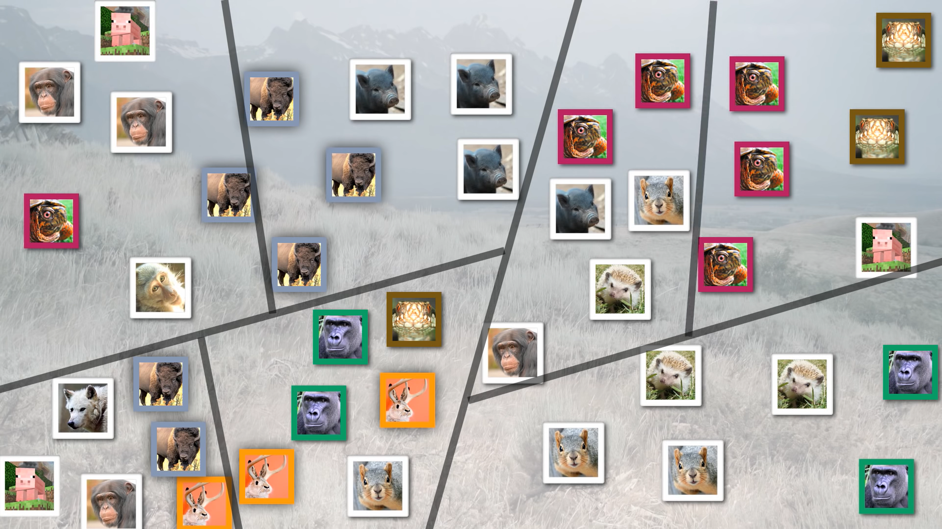
Shortest-splitline method

Slide 42
Borda count
1 ballot per voter, and you your preference list gives different given points from highest to least preferred
Typical usage: Sport Awards, BP debate teampoints, etc.

Slide 43
Mixed-member proportional
Doubles the seats, half of the seats are choosen with FPTP
Half of the seats are filled in a way that we compensate based on the party ballots with party lists
Advantages:
Prevents gerrymendering
Adds political diversity
Does not allow minority rule
Notable example: Very close to German-elections, but: 299 districts, 299 party politicians, and THEN they pill up the rest of the Parliament with proportional votes
What are the flaws?

Slide 44
Multiple non-transfereble vote
Quite a big cathegory: block voting might have lots of rules
Basically: N options, you can vote for n in total, and there is m winner
Most often: m = n
Alternative vote: N = n, m = 1
My favourite election system
This is what is most commonly used in traditional colleges of advanced studies, and Student Organizations
Notable examples: Debate Society’s admission board, SZISZ commities, student union representatives to ELTE Faculty of Science, municipal elections in Hungary
There is spillover effect, but you decide how much you want to have it ( it was a very debated topic in Szisz this autumn, because some ppl. really hated tactical voters)

Slide 45
Single transferable vote
Goal: maximize happiness
HARE: favours small parties → TH: 100% / n
DROOP: favours large parties → TH: 1% + 100% / (n+1)
Instant-runoff with multiple winners
Example: 24, 25, 51 → 1,1,1 with Hare, but 2, 1, 0 with Droop

Slide 46
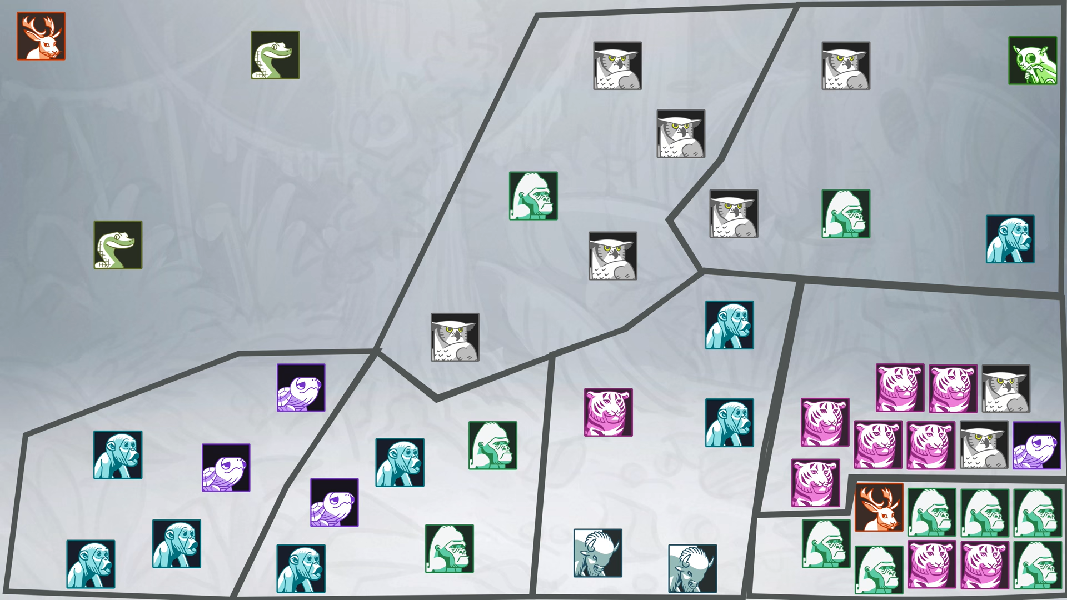
STV gerrymendering:

Slide 47
Other interesting voting systems
Coombs Rule IR, but you do not eliminate the voter with the least first votes but the candidate with the most last places
Goal of this: remove polarizing candidates
Disatvantages: Even someone, who is a summarized plurality winner, can lose the election
Cumulative Voting: Each voter is asked to distribute a fixed number of points, say ten, among the candidates in any way they please. The candidate(s) with the most total points wins the election.
Quadratic Voting: you can buy n votes for n x n units. We distrubute sum(n_i) after the voting

Slide 48
Cardinal voting
Basically vector-voting: you can proportionate how much you like an option on a scale
Notable examples: Giving grades for students, or any 1 to 10 list, feedback systems, BP speaker scores
What is the advantage?
What is the disatvantage?

Slide 49
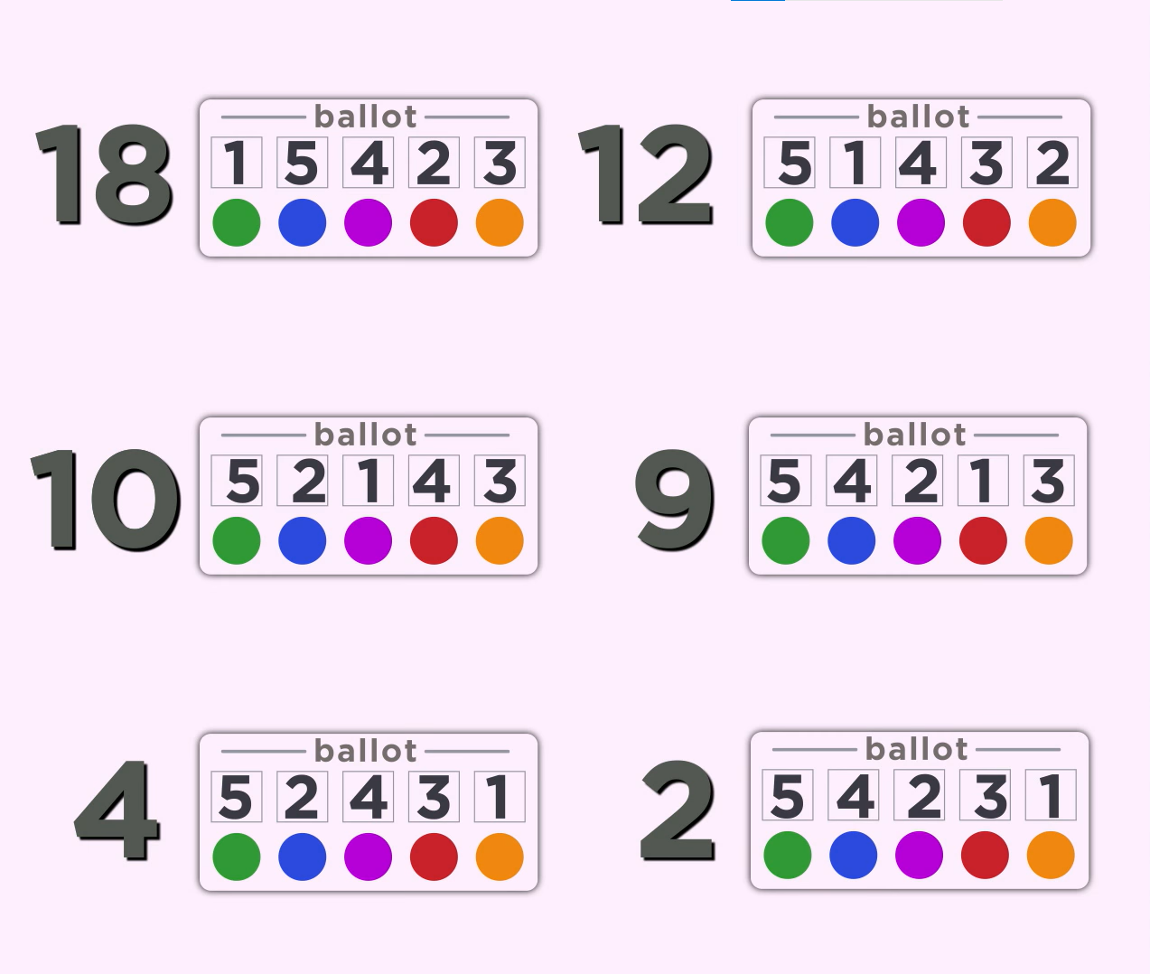
Do you have a favourite voting system? Let’s play a game!
https://www.youtube.com/watch?v=HoAnYQZrNrQ

Slide 50
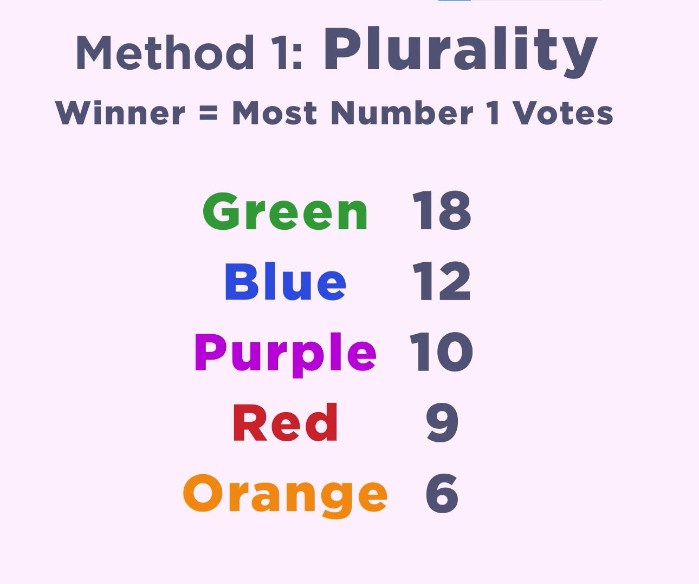

Slide 51
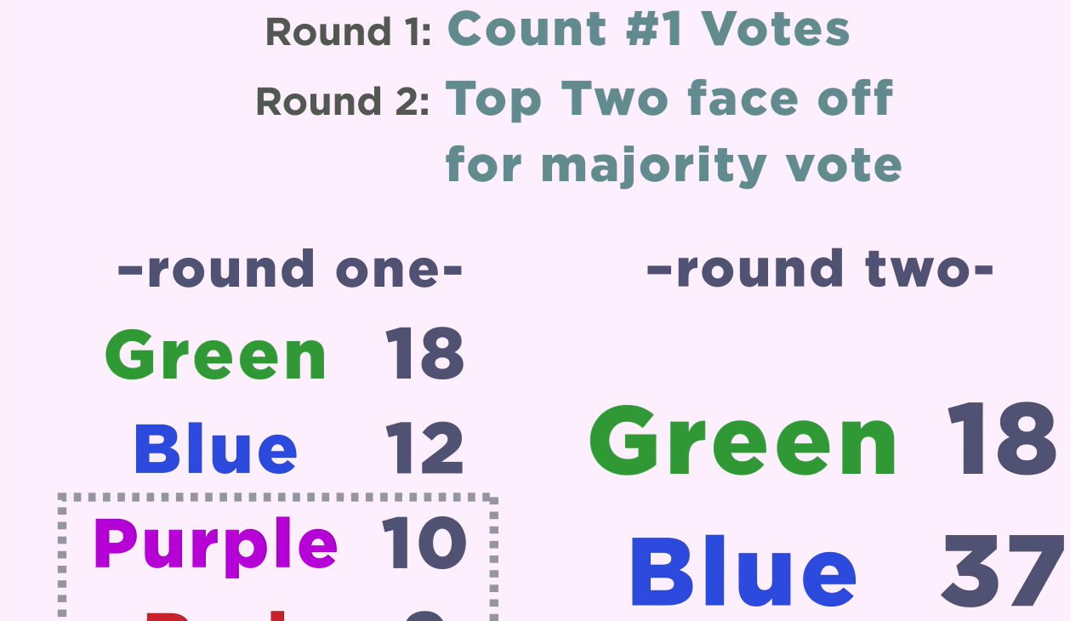

Slide 52
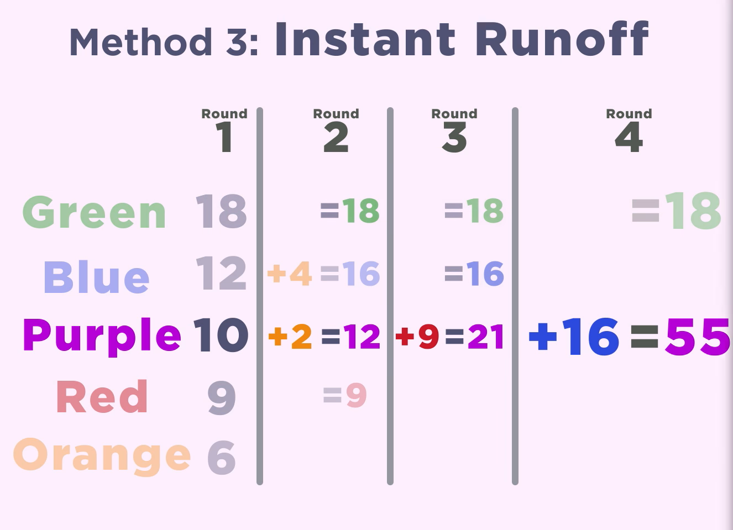

Slide 53
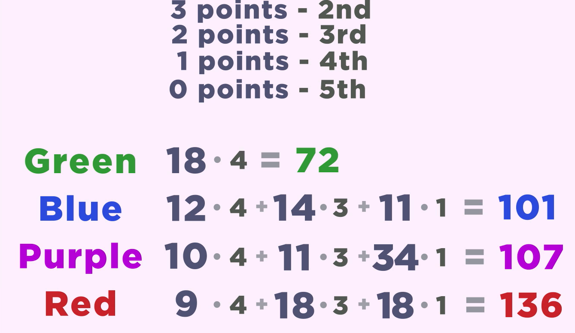

Slide 54
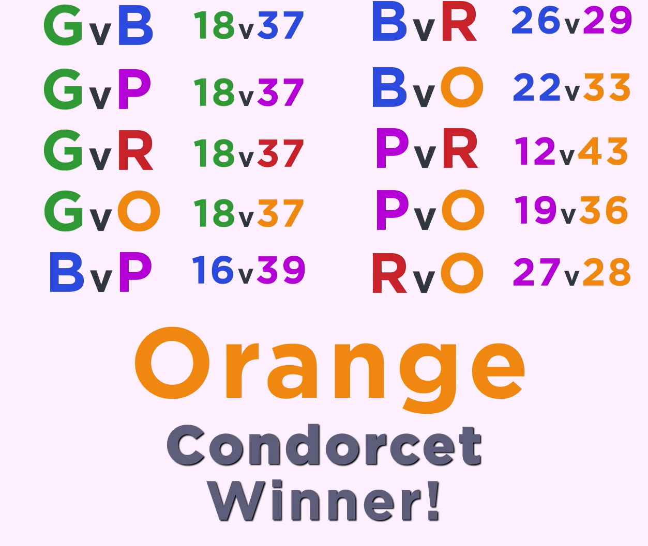

Slide 55
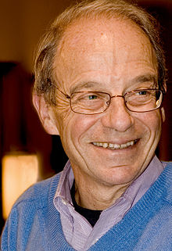
Let’s make everything simpler: referendums
Brams, Kilgour, Zwicker: The paradox of multiple elections (1998)
1) THW legalize marijuana
2) THW taxate IQ
3) THW introduce UBI

Slide 56
Let’s make everything simpler: referendums
Brams, Kilgour, Zwicker: The paradox of multiple elections (1998)
1) THW legalize marijuana
2) THW taxate IQ
3) THW introduce UBI
# of voters | Propositions
1 | YYY
1 | YYN
1 | YNY
3 | YNN
1 | NYY
3 | NYN
3 | NNY
0 | NNN
# of voters | Propositions
1 | YYY
1 | YYN
1 | YNY
3 | YNN
1 | NYY
3 | NYN
3 | NNY
1 | NNN
„The paradox does not just highlight problems of aggregation and packaging, however, but strikes at the core of social choice—both what it means and how to uncover it. In our view, the paradox shows there may be a clash between two different meanings of social choice, leaving unsettled the best way to uncover what this elusive quantity is.”

Slide 57
Weird gets weirder: Anscombe & Ostrogorski paradox
 | Issue 1 | Issue 2 | Issue 3
Voter 1 | Yes | No | Yes
Voter 2 | No | No | No
Voter 3 | No | Yes | Yes
Voter 4 | Yes | No | Yes
Voter 5 | Yes | No | Yes
Majority | Yes | No | Yes
 | Issue 1 | Issue 2 | Issue 3
Candidate A | Yes | No | Yes
Candidate B | No | Yes | No
Anscombe: majority of people disagree with the majority outcome...
Ostrogorski: Candidate A, who agrees with the majority opinion, will loose the election to a... Trump?

Slide 58
Weird gets weirder: Anscombe & Ostrogorski paradox
 | Issue 1 | Issue 2 | Issue 3
Voter 1 | Yes | Yes | No
Voter 2 | No | No | No
Voter 3 | No | Yes | Yes
Voter 4 | Yes | No | Yes
Voter 5 | Yes | No | Yes
Majority | Yes | No | Yes
 | Issue 1 | Issue 2 | Issue 3
Candidate A | Yes | No | Yes
Candidate B | No | Yes | No
Anscombe: majority of people disagree with the majority outcome...
Ostrogorski: Candidate A, who agrees with the majority opinion, will loose the election to a... Trump?

Slide 59
Voting systems in Europe
https://www.youtube.com/watch?v=6gw4w2OPgig

Slide 60
Reasons of not to vote
https://www.youtube.com/watch?v=_gbDAvK42yA
https://www.youtube.com/watch?v=FPyql3yEGP8
1) Favourite has 0 chance
2) Favourite will win
3) Hate all of them
4) Does not feel educated
Comp V: https://www.youtube.com/watch?v=FNjwFvbvHdE
https://www.youtube.com/watch?v=D7nGCzmNi44

Slide 61
Practice: Let’s try to win elections

Slide 62
Takeaways
Almast always there are no absolute truths or absolute wrongs in history
When the sum of individual choices emerges as a public choice, a final decision is usually a fallacy of the system, not a triumph of justice.
Still: go and vote! Use your freedom!

Slide 63
Thank you for your questions! Q&A:

Slide 64
And the motion for today...

Slide 65
And the motion for today...
This House Would make voting mandatory

